Slide 1
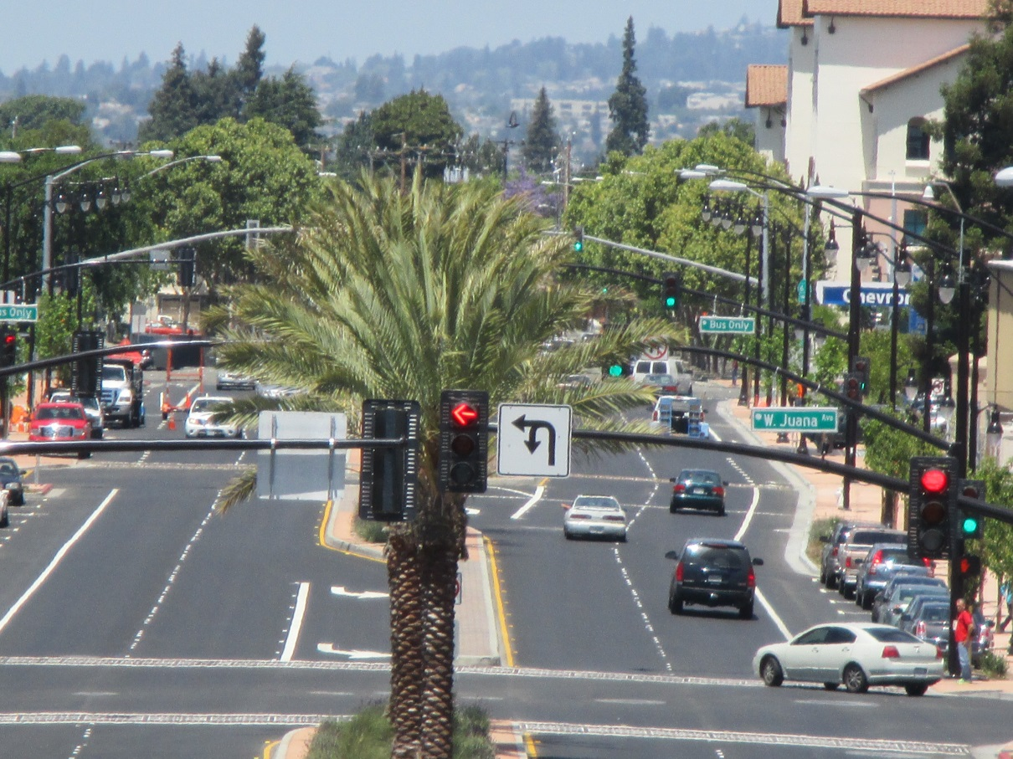
2016 Save California Streets Award Program Name of Project: Bart-Downtown Pedestrian Interface
Location: San Leandro Boulevard, San Leandro, CA
View: Looking north from intersection of Parrot Street
Category: Complete Streets and Multi-Modal Mobility Projects
Entrant: City of San Leandro

Slide 2
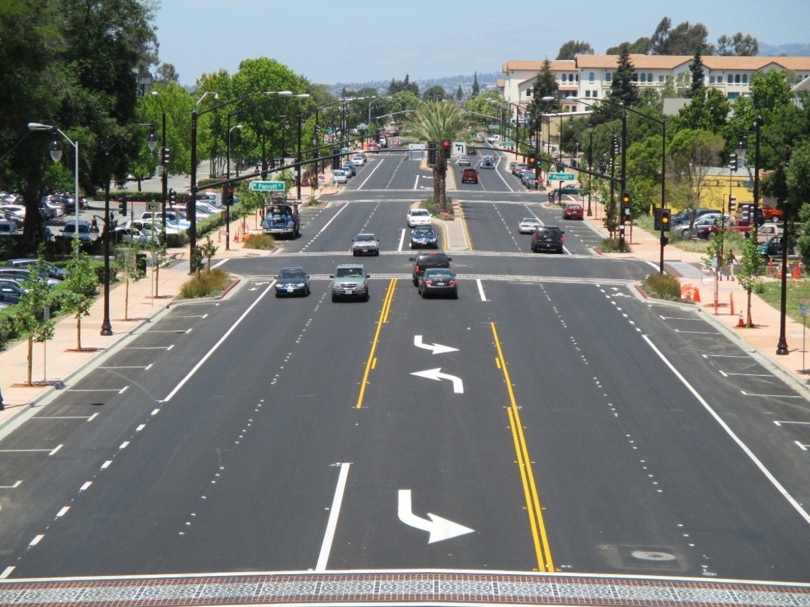
2016 Save California Streets Award Program Name of Project: Bart-Downtown Pedestrian Interface
Location: San Leandro Boulevard, San Leandro, CA
View: Looking north from intersection of Thornton Street
Category: Complete Streets and Multi-Modal Mobility Projects
Entrant: City of San Leandro

Slide 3
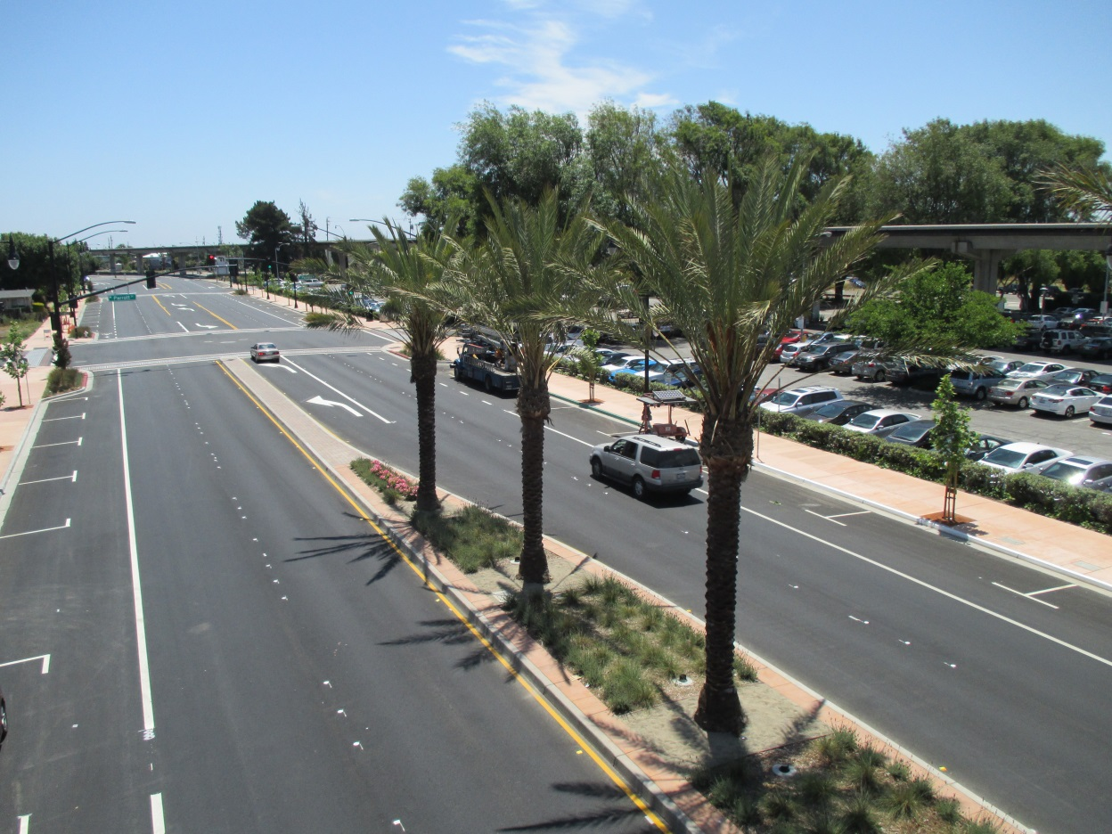
2016 Save California Streets Award Program Name of Project: Bart-Downtown Pedestrian Interface
Location: San Leandro Boulevard, San Leandro, CA
View: looking south from intersection of West Juana Avenue
Category: Complete Streets and Multi-Modal Mobility Projects
Entrant: City of San Leandro

Slide 4
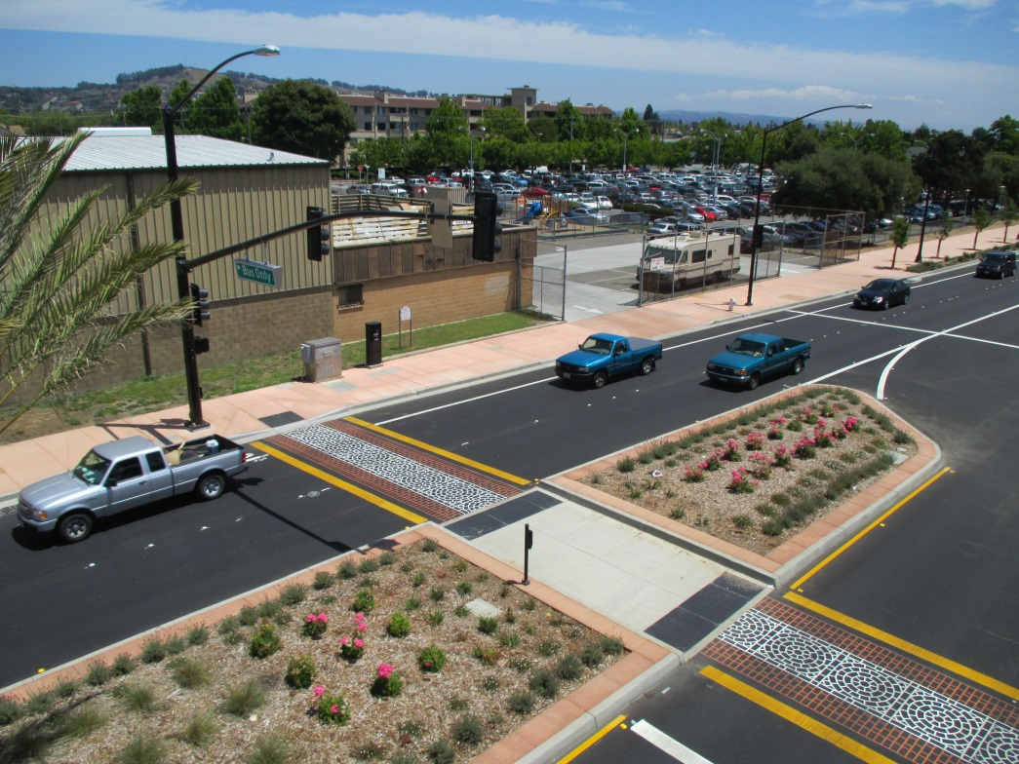
2016 Save California Streets Award Program Name of Project: Bart-Downtown Pedestrian Interface
Location: San Leandro Boulevard, San Leandro, CA
View: Looking east from SL Bart Station Bus entrance
Category: Complete Streets and Multi-Modal Mobility Projects
Entrant: City of San Leandro

Slide 5
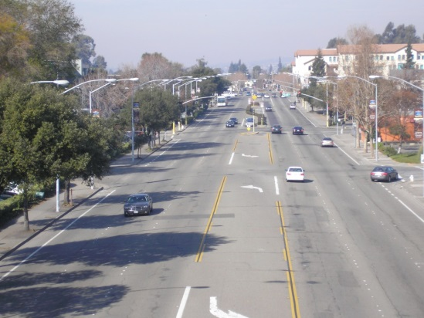
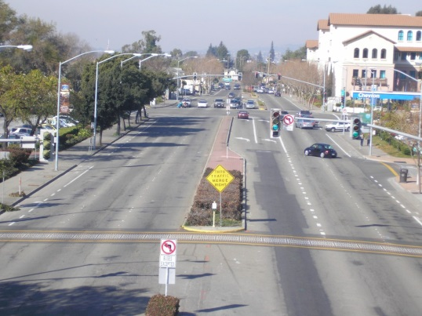
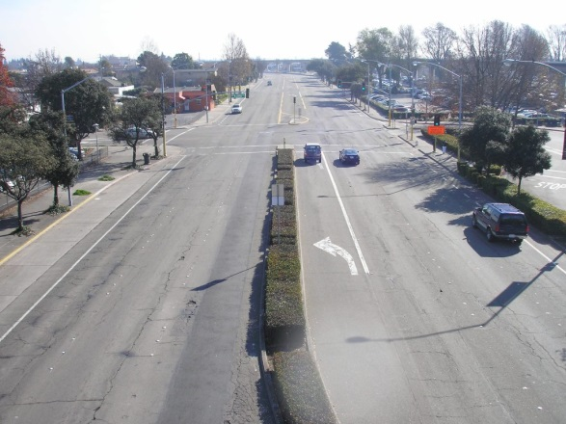
2016 Save California Streets Award Program Name of Project: Bart-Downtown Pedestrian Interface
Location: San Leandro Boulevard, San Leandro, CA
Views: Pre-construction photos looking north from Thornton Street, Parrott Street, and south from Davis Street
Category: Complete Streets and Multi-Modal Mobility Projects
Entrant: City of San Leandro

Slide 6
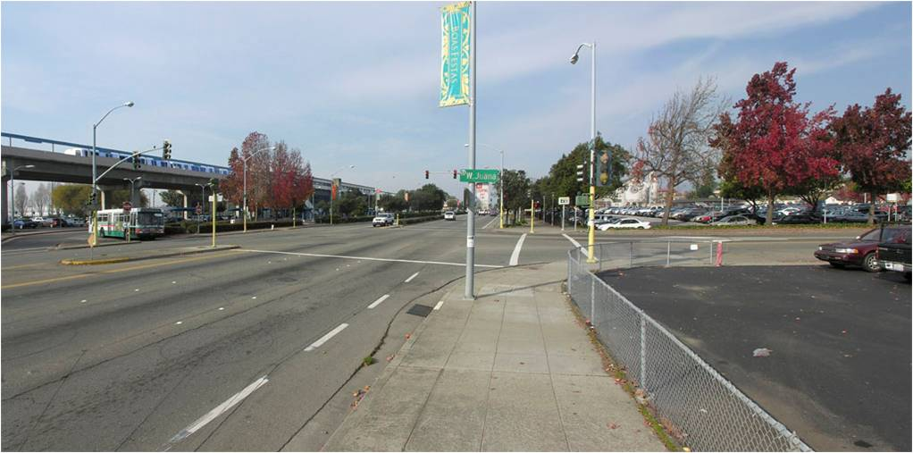
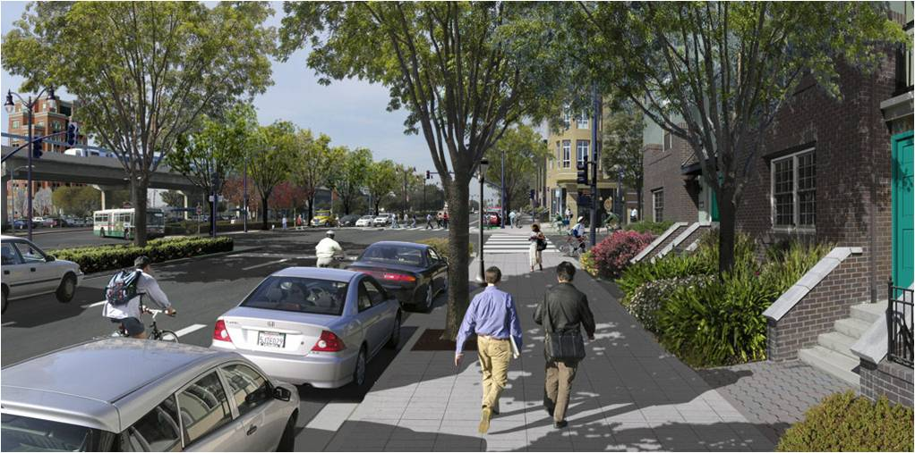
2016 Save California Streets Award Program Name of Project: Bart-Downtown Pedestrian Interface
Location: San Leandro Boulevard, San Leandro, CA
Views: Pre-construction (north view), Post-construction (south view),
and Architectural rendering of future TOD development at West Juana intersection (north view)
Category: Complete Streets and Multi-Modal Mobility Projects
Entrant: City of San Leandro

