Slide 1
California Statewide Local Streets & Roads Needs Assessment - 2020 Update
Add your agency info here

Slide 2
Project Sponsors
California State Association of Counties (CSAC)
League of California Cities (League)
County Engineers Association of California (CEAC)
Regional Transportation Planning Agencies (RTPA)
Rural Counties Task Force (RCTF)

Slide 3
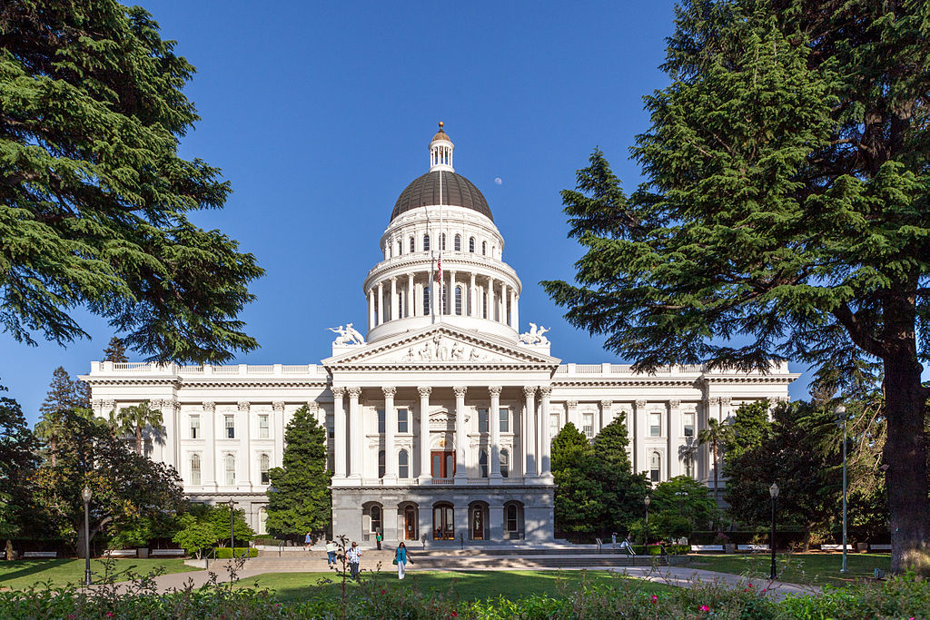
Has this project been successful?

Slide 4
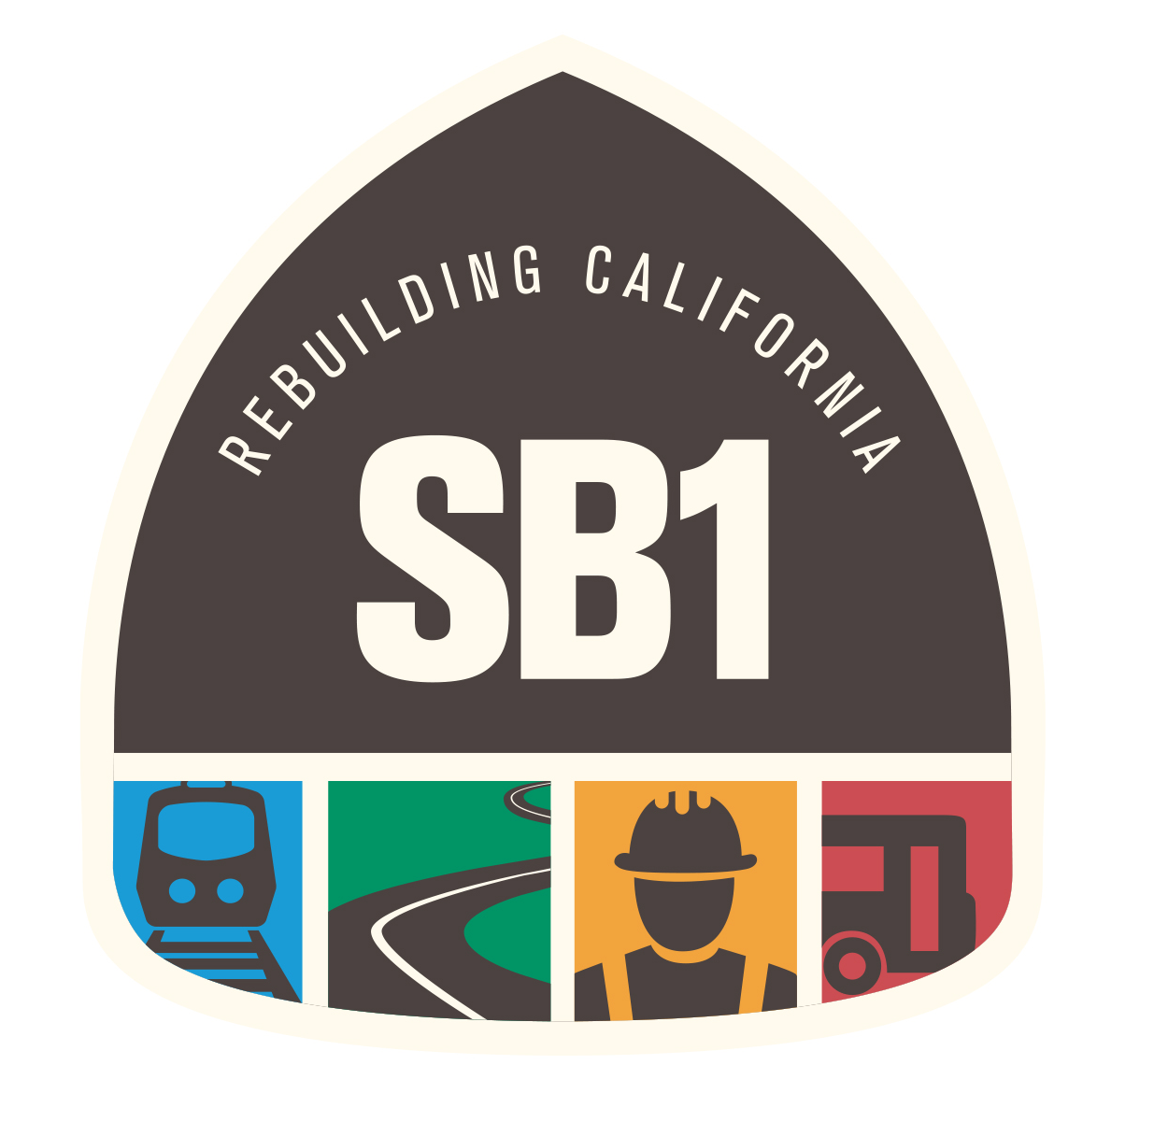
Senate Bill No. 1
Approved by Governor April 28, 2017
SECTION 1.
The Legislature finds and declares all of the following:
(a) Over the next 10 years, the state faces a $59 billion shortfall to adequately maintain the existing state highway system in order to keep it in a basic state of good repair.
(b) Similarly, cities and counties face a $78 billion shortfall over the next decade to adequately maintain the existing network of local streets and roads.
***
(1) The revenues estimated to be available for allocation under the act to local agencies are estimated over the next 10 years to be as follows:
(A) Fifteen billion dollars to local street and road maintenance.
Notes:
https://leginfo.legislature.ca.gov/faces/billTextClient.xhtml?bill_id=201720180SB1

Slide 5
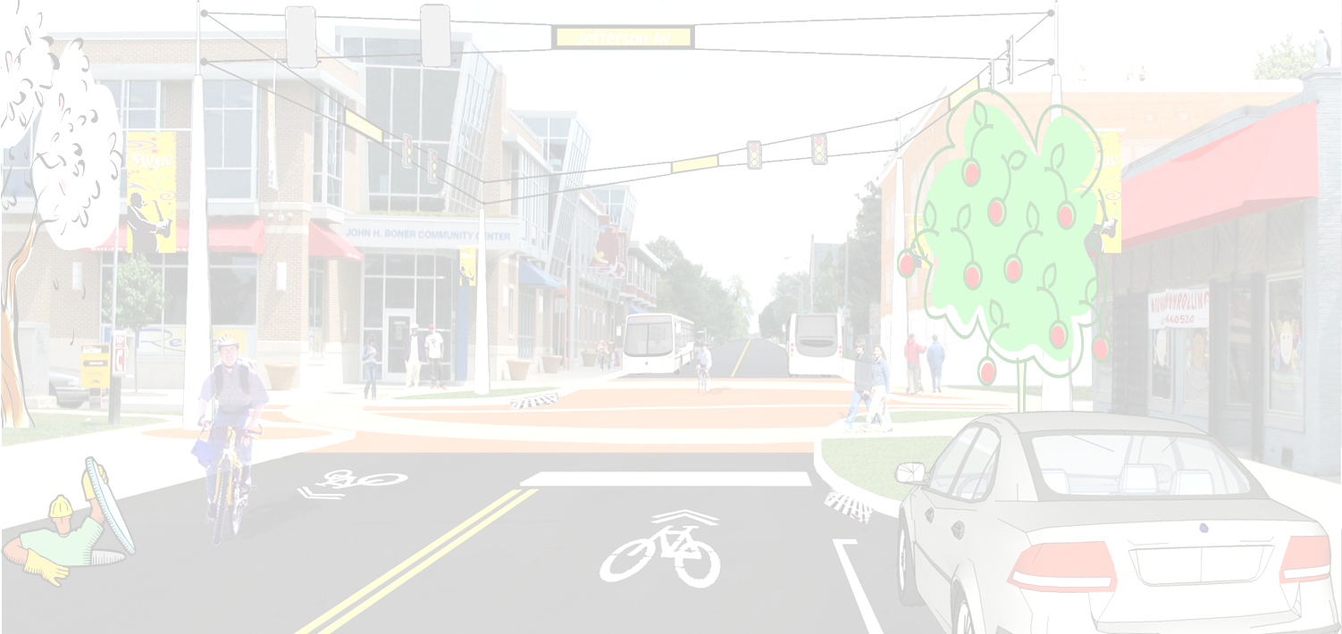
Project Objectives
What are pavement conditions statewide?
How much will it cost to maintain local roads? Bridges? Essential components?
What is the funding shortfall?
What are impacts of different funding scenarios?
Communicate results to elected officials, the public and the media!

Slide 6
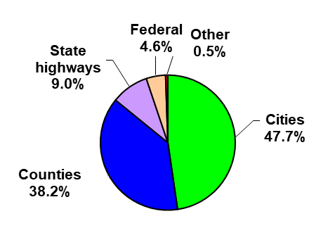
Local Roads Are A Huge Part of California’s Network
More than 85% of California’s roads are owned by cities and counties. That’s more than 144,000 centerline miles.

Slide 7

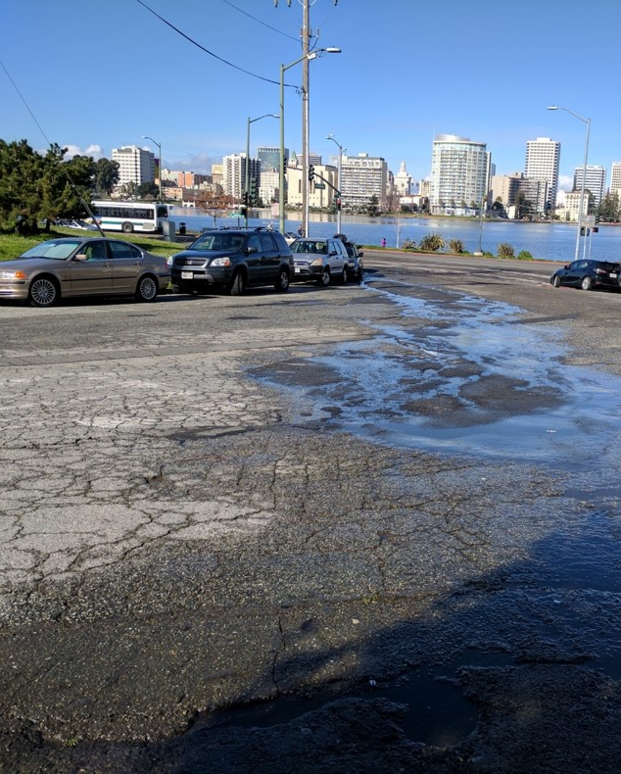
Pavements

Slide 8
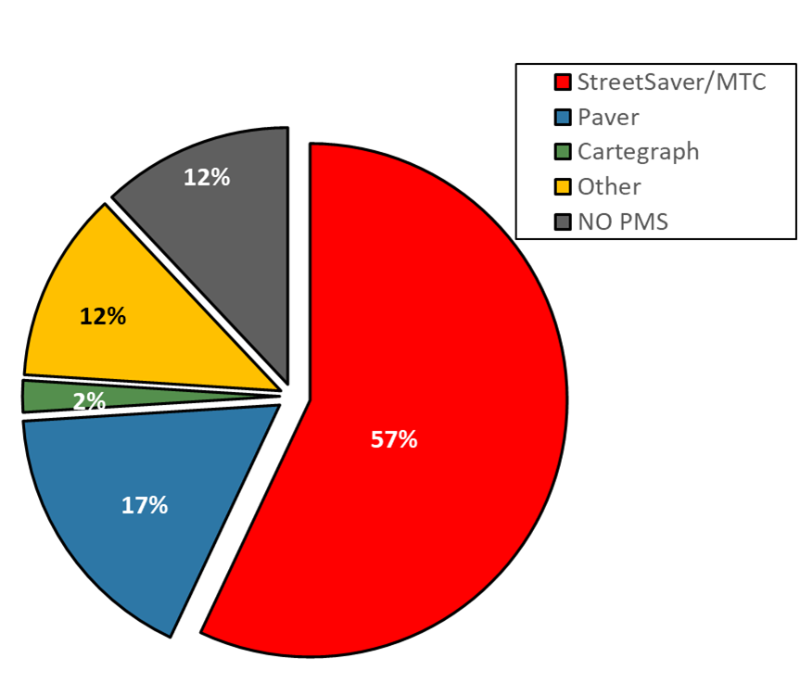
Survey Responses – PMS Software
98% of total miles are included in a pavement management system

Slide 9
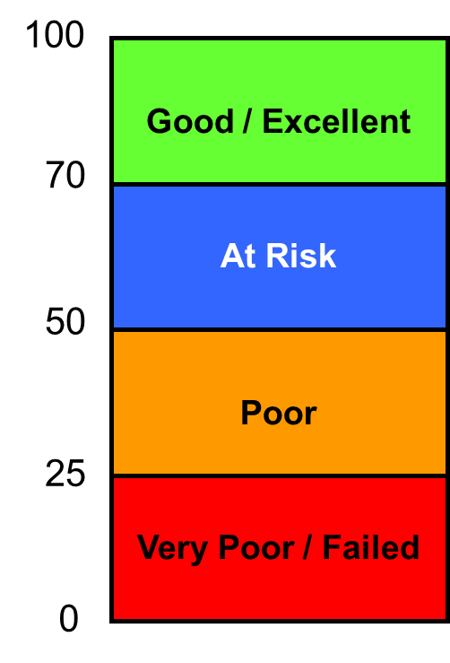
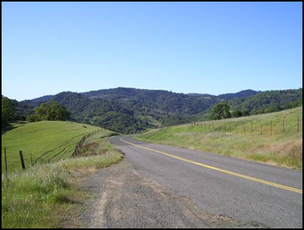
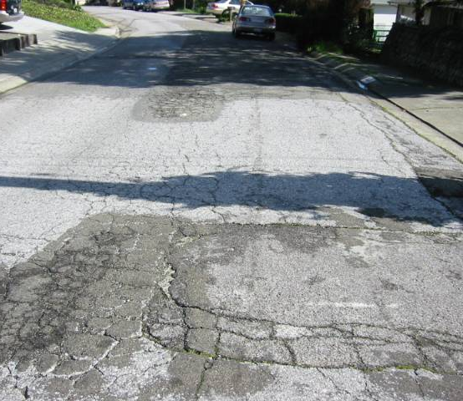
Average Statewide PCI
2020
Average PCI = 66
Cities = 68
Counties = 61
68 (2008)
66 (2012/2014)
65 (2016/2018)
Notes:
2020
PCIs of #335 agencies reported in 2020. They all increase by 1 point.
County PCI - 61.3 (#43 counties) - 60.2 (2018)
City PCI - 68.3 (#292 cities) - 67.3 (2018)
Average PCI - 65.7 - 64.7 (2018)
2106 PCI = 65.42
2018 PCI = 64.76
2012
Cities = 68
Counties = 62
2010
Cities = 68
Counties = 64

Slide 10
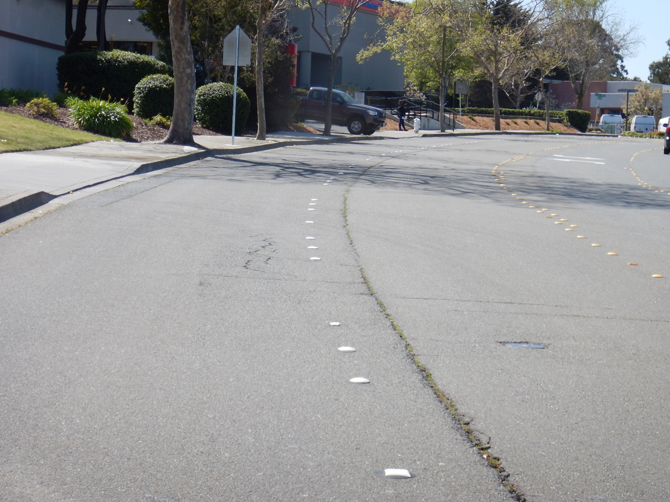
PCI of 66 Looks Like This

Slide 11
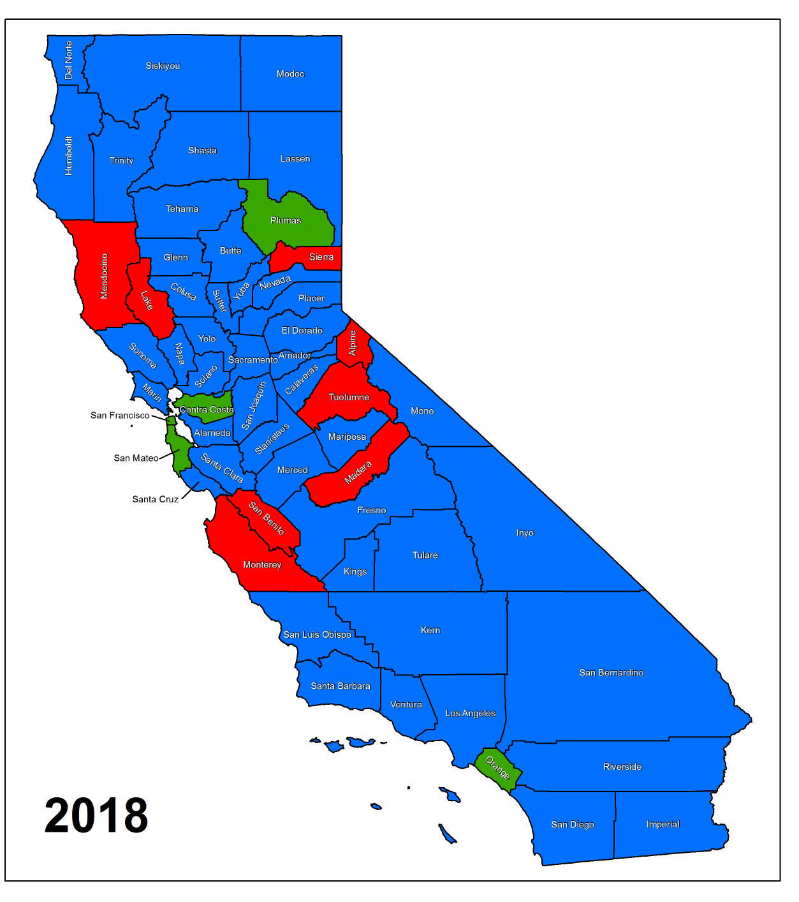
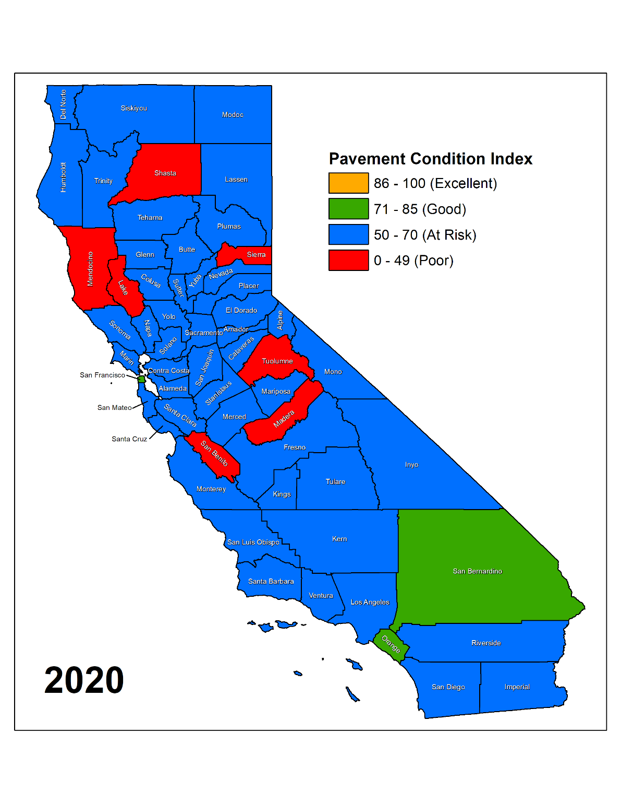
Average PCIs Don’t Tell the Whole Story
Average PCI = 65
Average PCI = 66
Notes:
#
County
Category Change
2018 Color
2020 Color
PCI Notes
1
Alpine
Better
Red
Blue
2018 PCI (41) – use 2016 data; 2020 PCI (58) – NCE updated PMP after 2018 statewide survey
2
Contra Costa
Worse
Green
Blue
2018 PCI (71); 2020 PCI (70.2)
3
Monterey
Better
Red
Blue
Most of agencies with updated PCI this year
4
Plumas
Worse
Green
Blue
2018 PCI (73); 2020 PCI (70.8)
5
San Bernardino
Better
Blue
Green
More agencies responded in 2020 survey (14 agencies, it was only 9 agencies in 2018)
San Bernardino County – PCI changes from 74 to 85 in 2020 (2645 CL miles)
Twentynine Palms – PCI changes form 71 to 77 in 2020 (158 CL miles)
6
San Mateo
Worse
Green
Blue
2018 PCI (72); 2020 PCI (70.8); all from MTC
San Mateo County – PCI changes from 74 to 53 in 2020
Pacifica – PCI changes from 51 to 41 in 2020
7
Shasta
Worse
Blue
Red
Shasta County did PMP update after 2018 Statewide survey. County PCI went from 64 (2018 incorrect number) to 50.

Slide 12
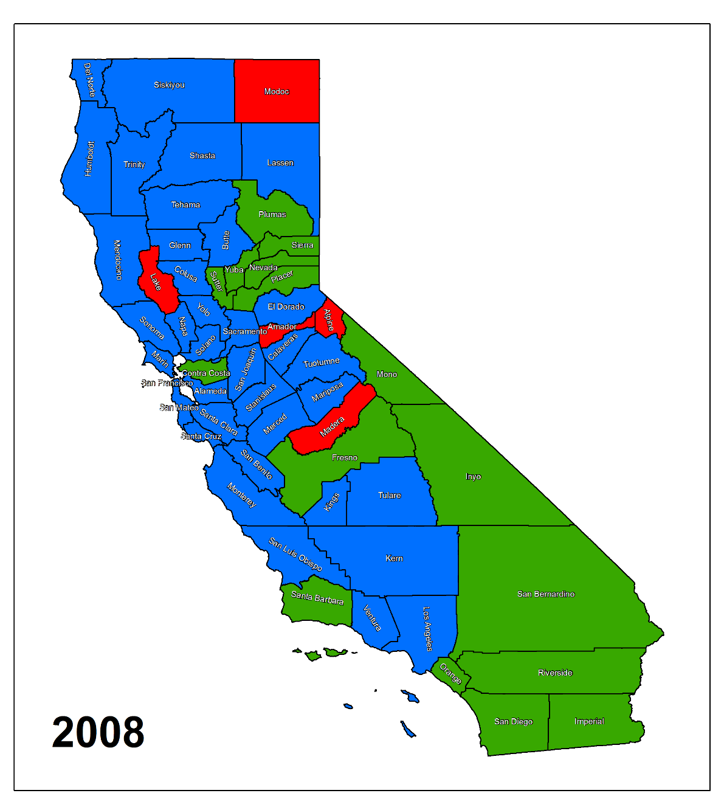
Compare 2008 with 2020
12 Years Ago …
Average PCI = 68
Average PCI = 66

Slide 13
Condition of [City/County] Local Roads
City/County has an average PCI of ____.
This is up/down from ____ in 2018.
Insert other City/County specific details on the condition of your local street and road system.

Slide 14
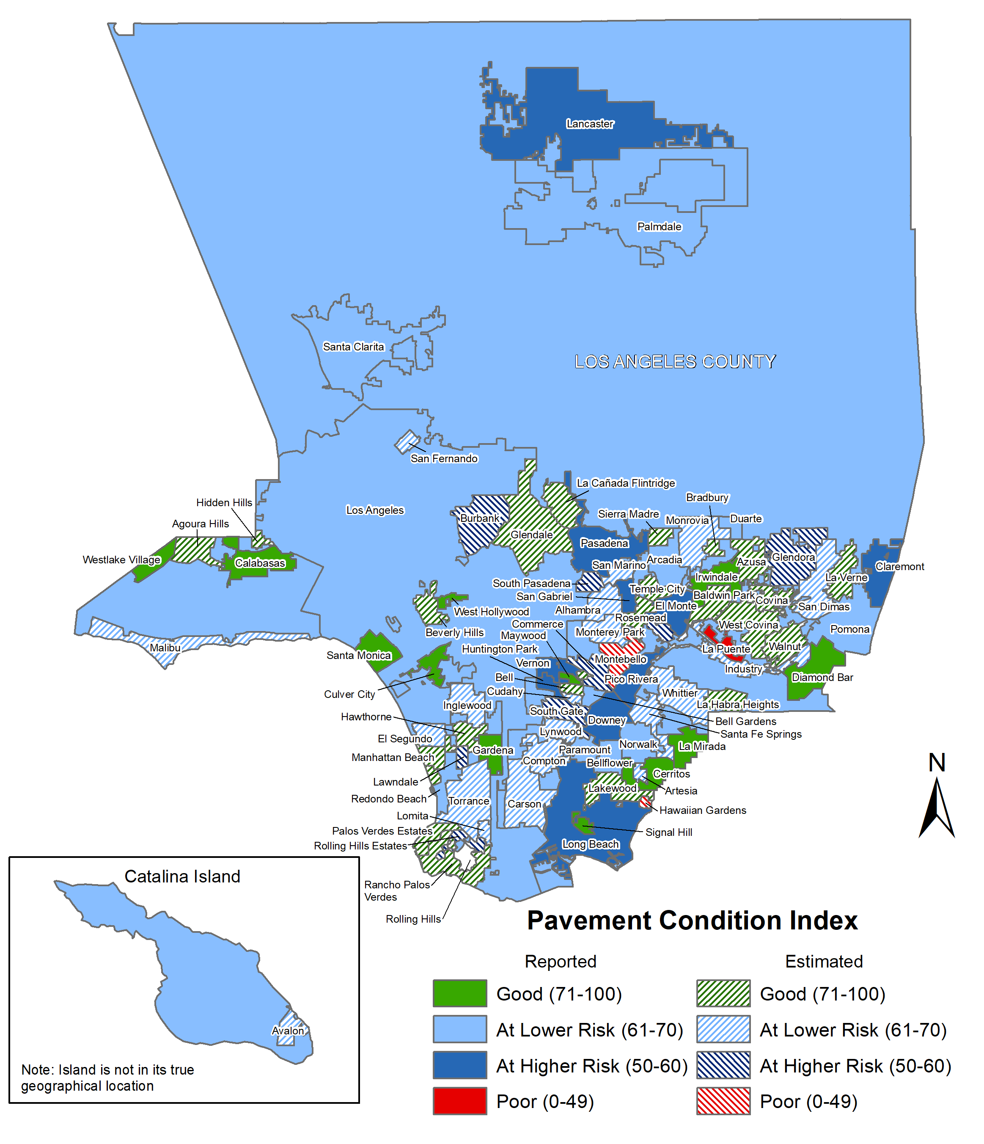
Los Angeles Co.
Average PCI = 68
Insert your county PCI map here
Maps are available in Appendix C of Final Report

Slide 15
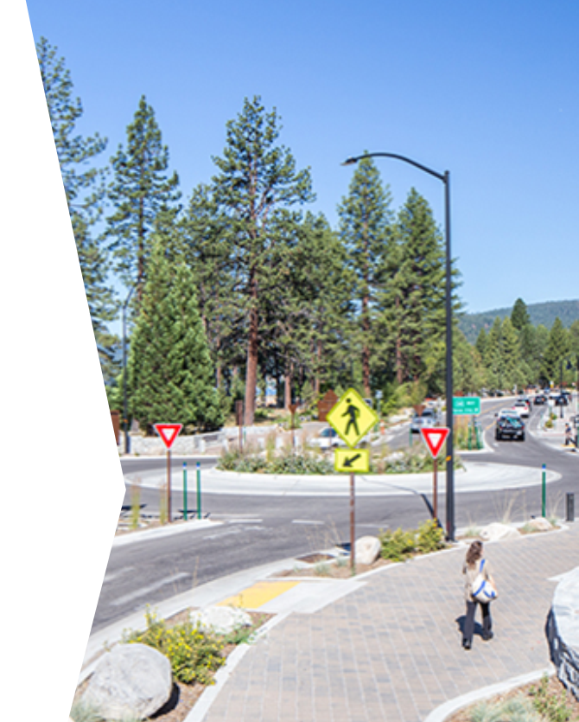
Complete Streets

Slide 16
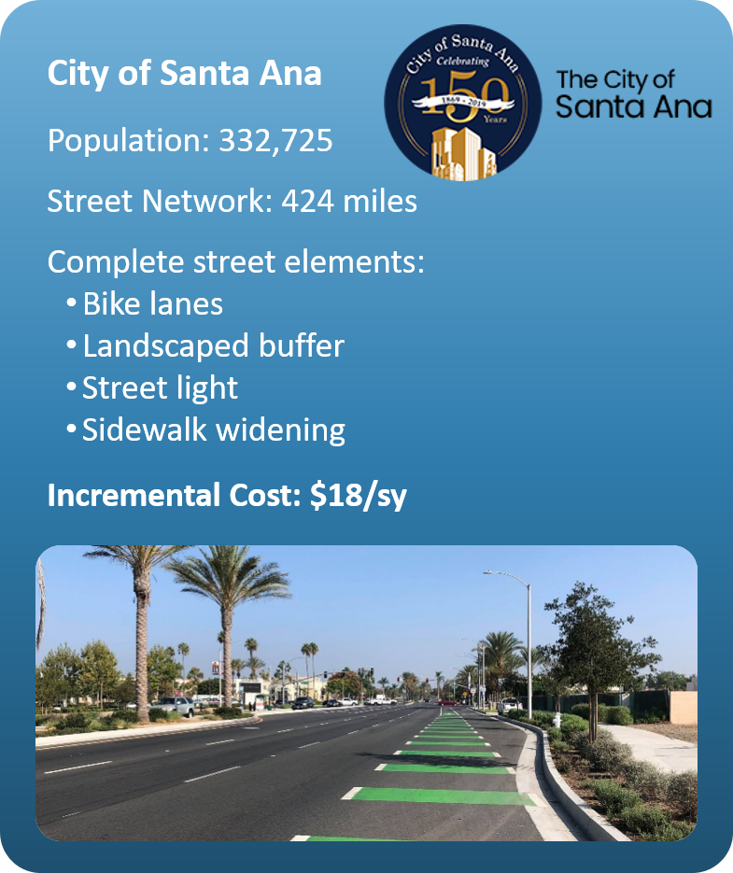
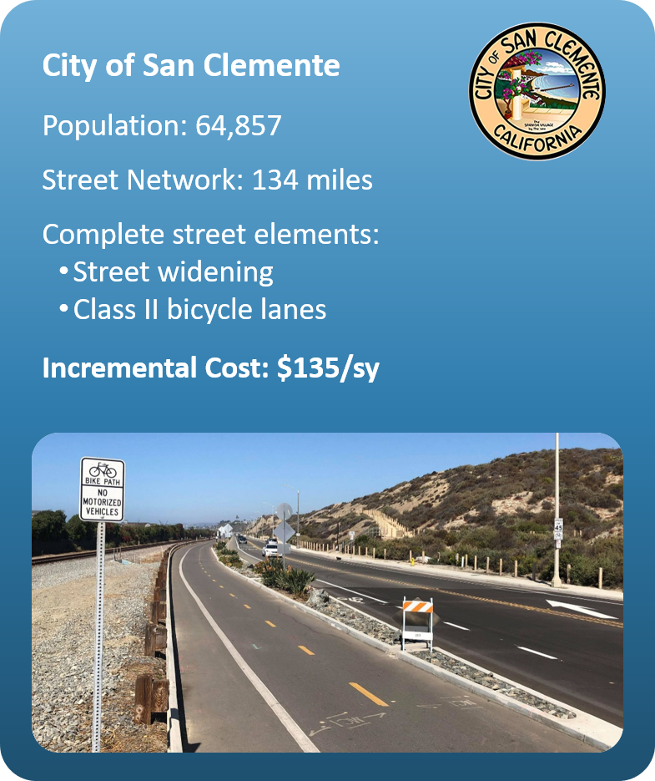
Huge Range in Incremental Costs
Average $117/sy

Slide 17
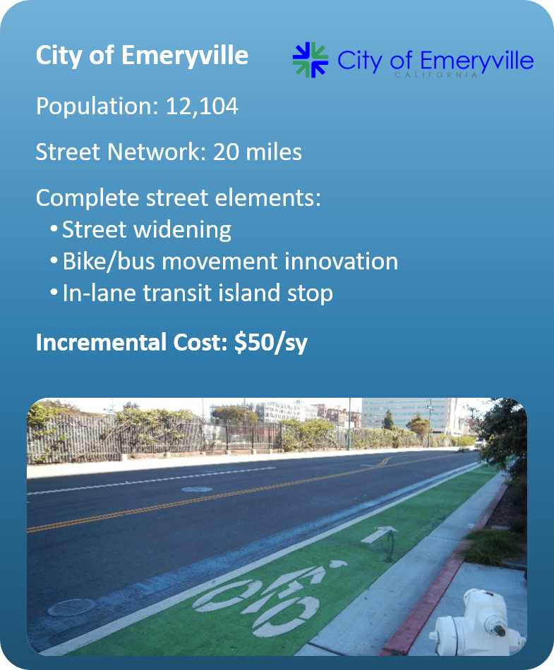
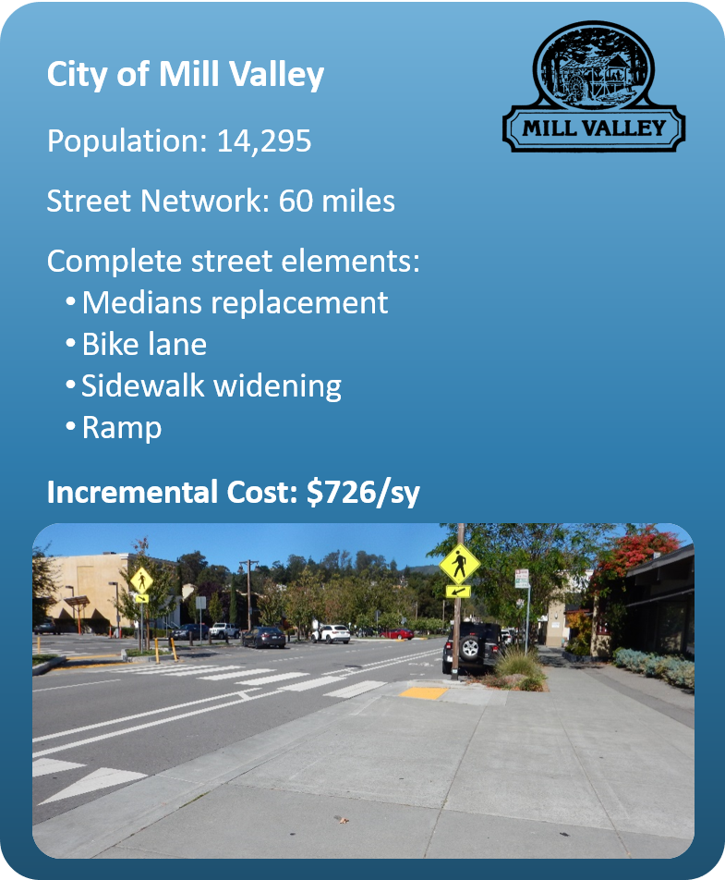
Huge Range in Incremental Costs
Average $117/sy

Slide 18
Additional Regulatory Requirements
Responses are guesstimates but needs are consistently about $9.6 billion.
Notes:
2016 – Needs

Slide 19
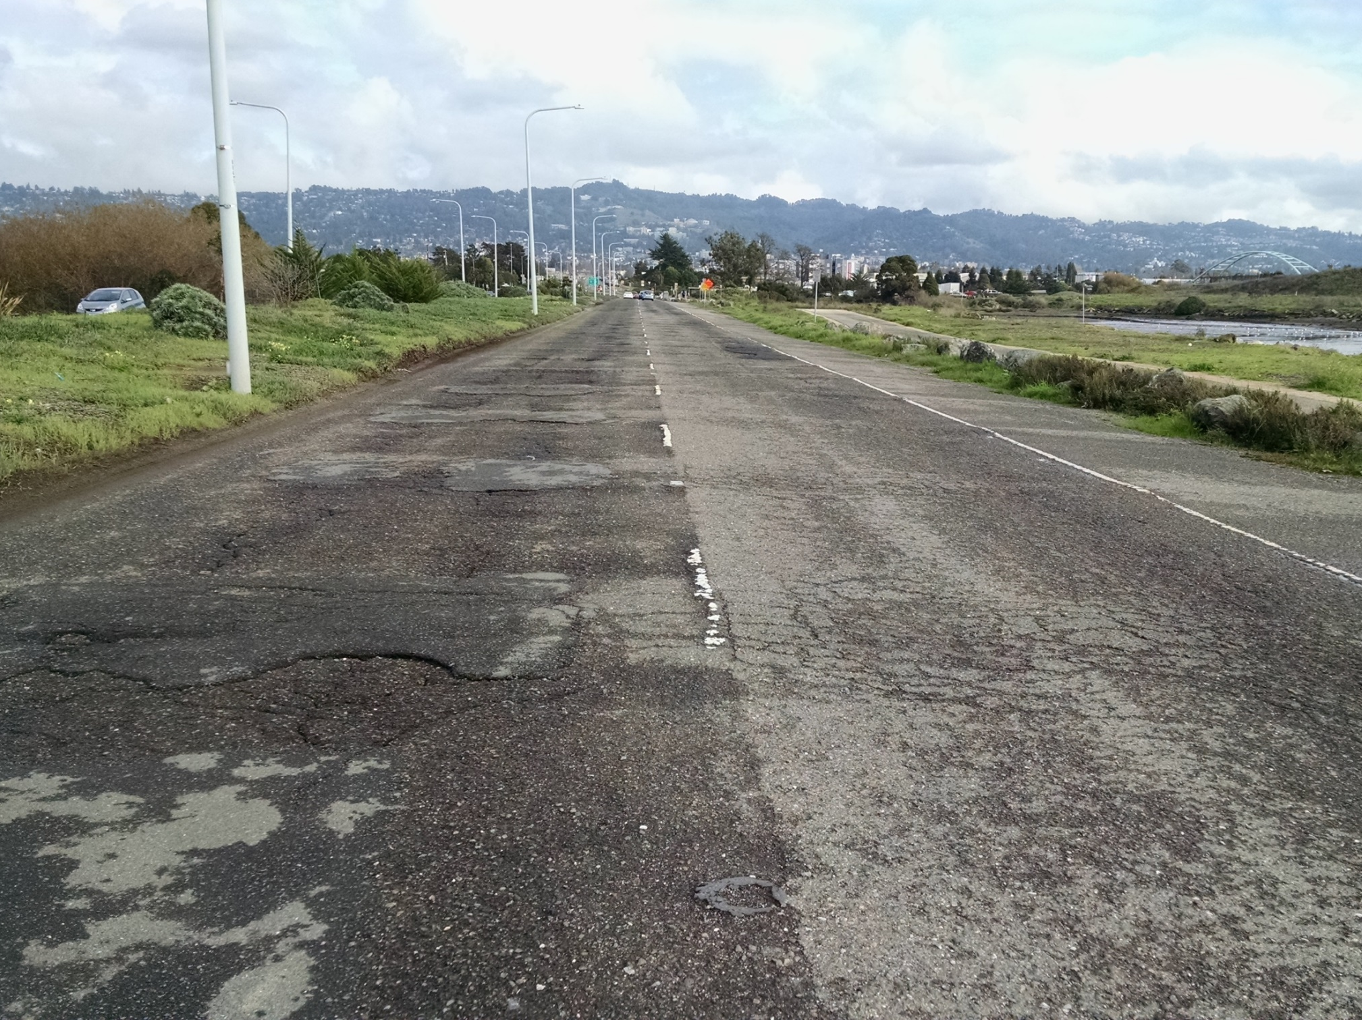
Total Pavement Needs = $76 billion
Notes:
2016 $70 billion
2018 $61.7 billion
2020 $75.3 billion (22% increase)

Slide 20
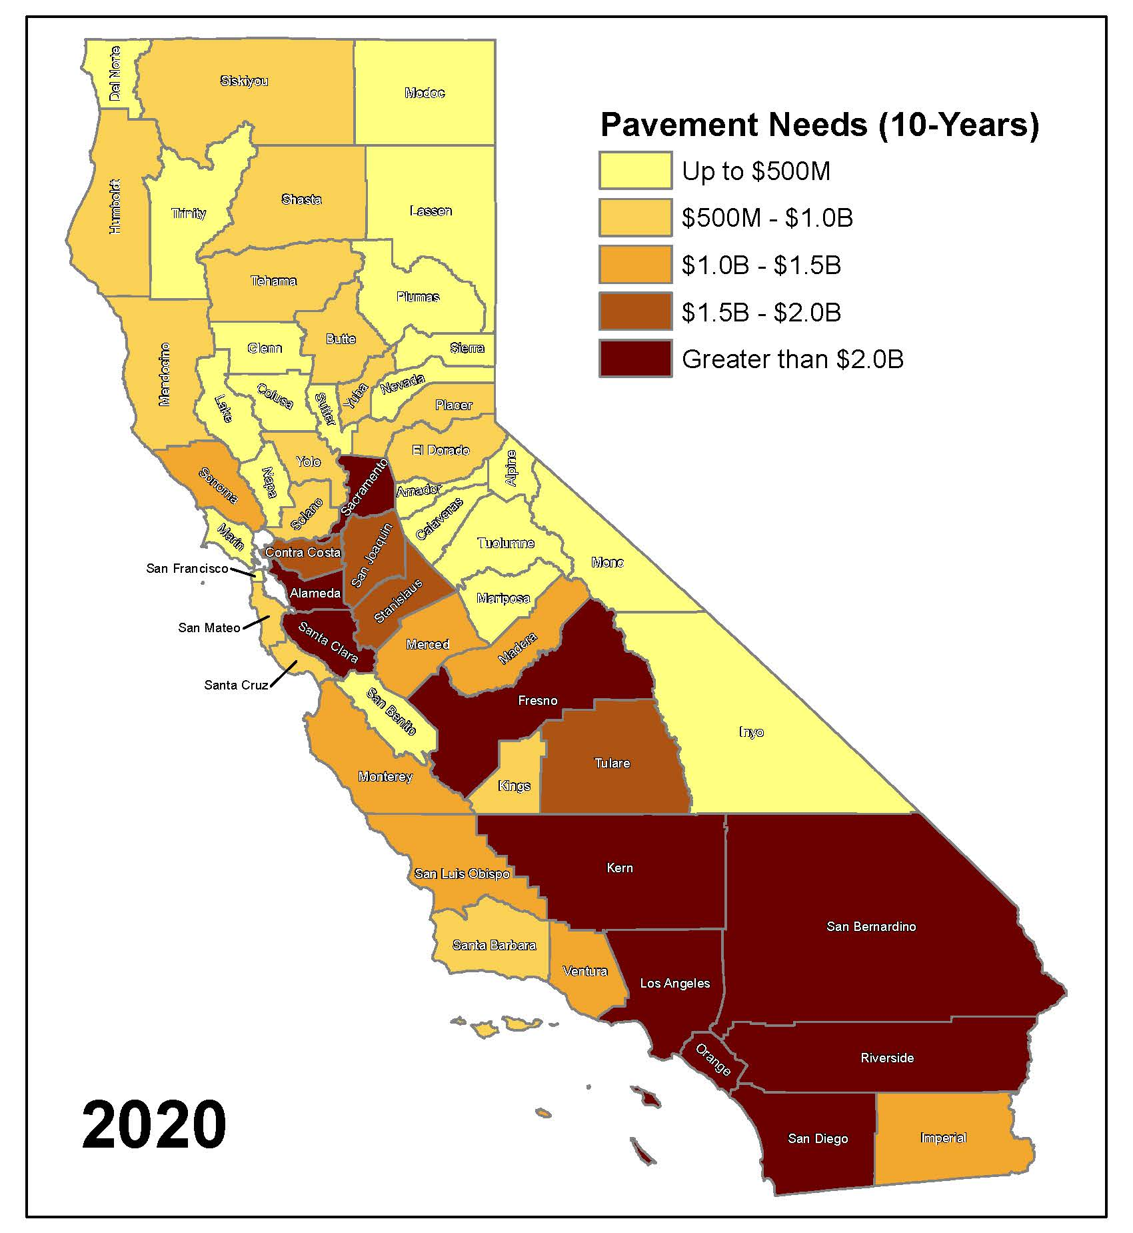
Pavement Needs by County
See Final Report (Appendix C) for your County’s data
LA county needs $12 billion

Slide 21
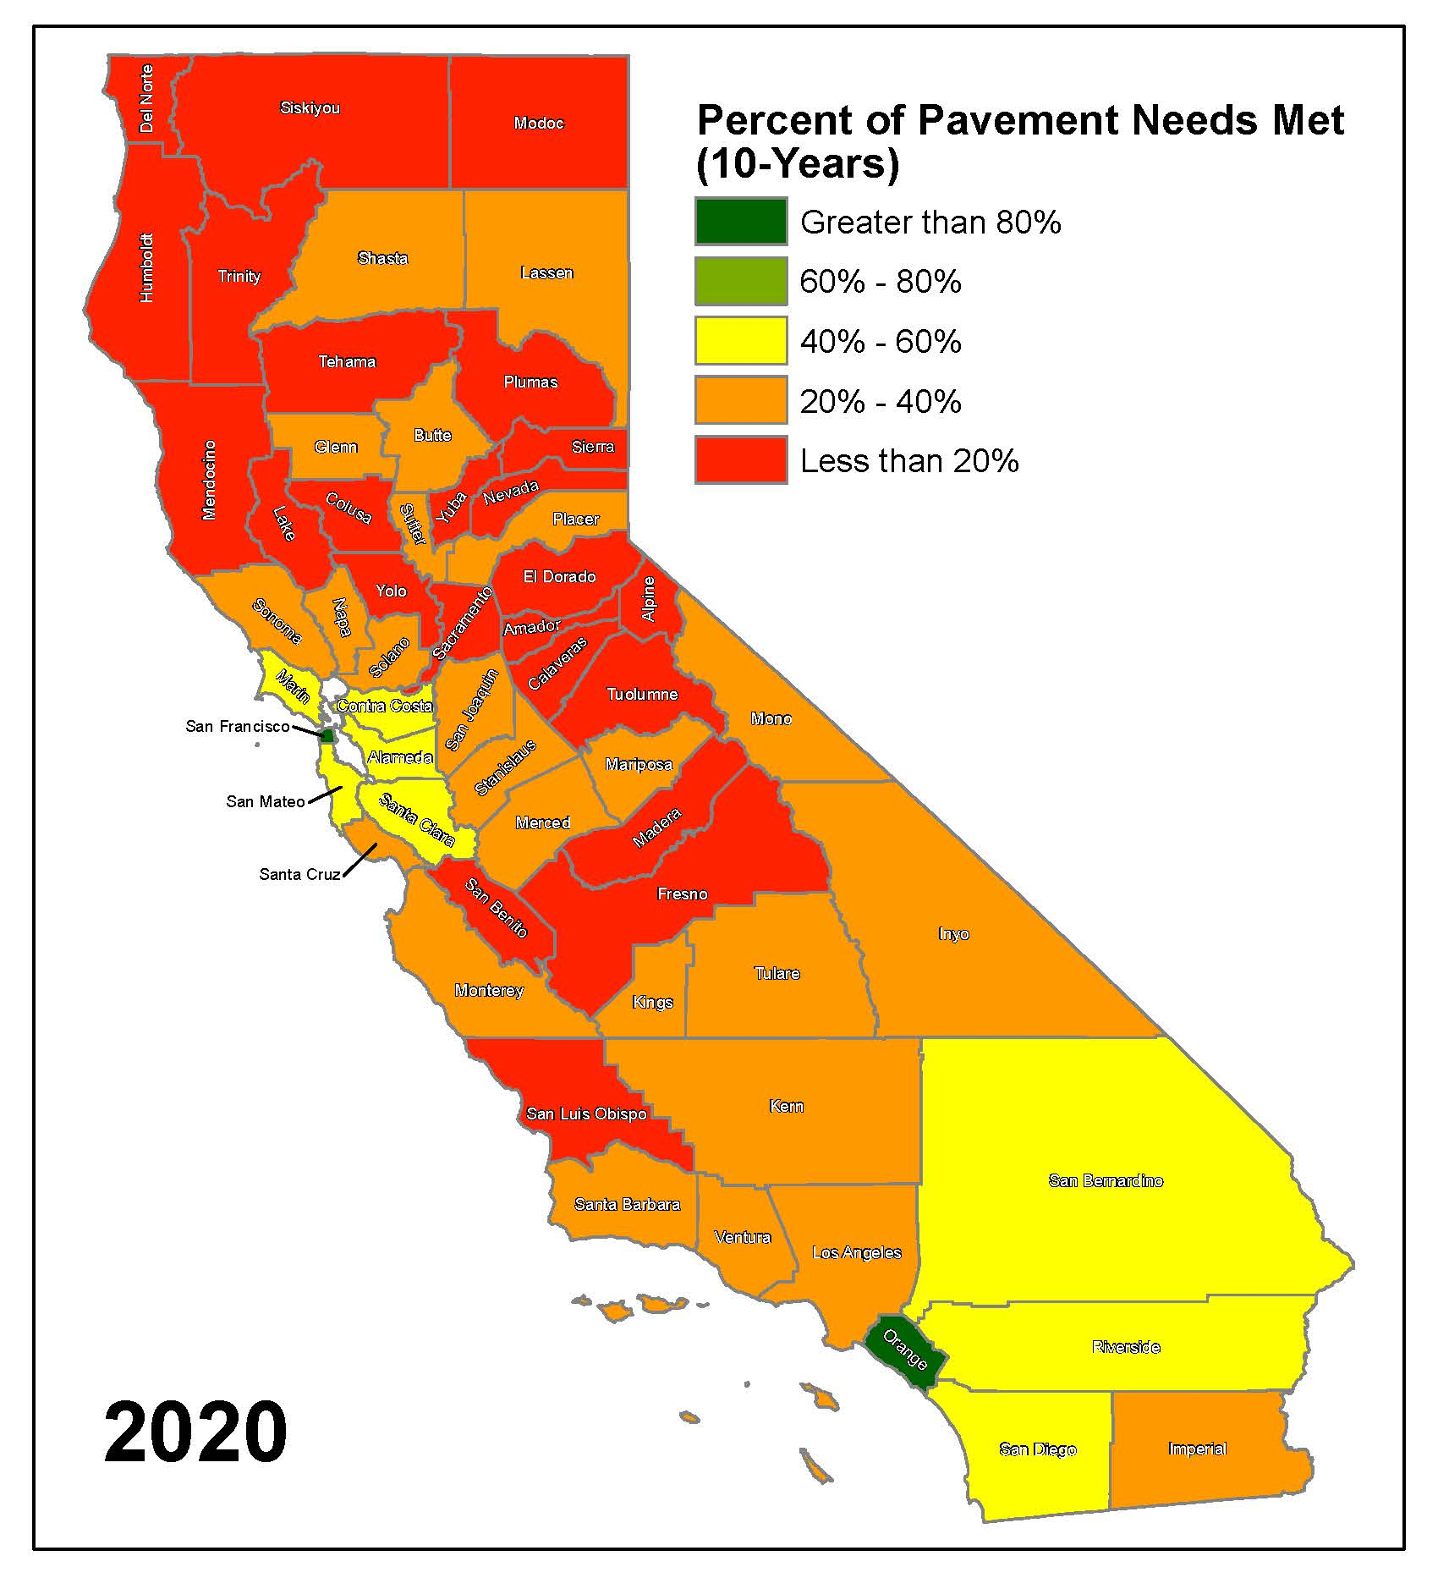
Pavement Needs Met by County
See Final Report (Appendix C) for your County’s data
Less than 40% of needs are met with current funding

Slide 22
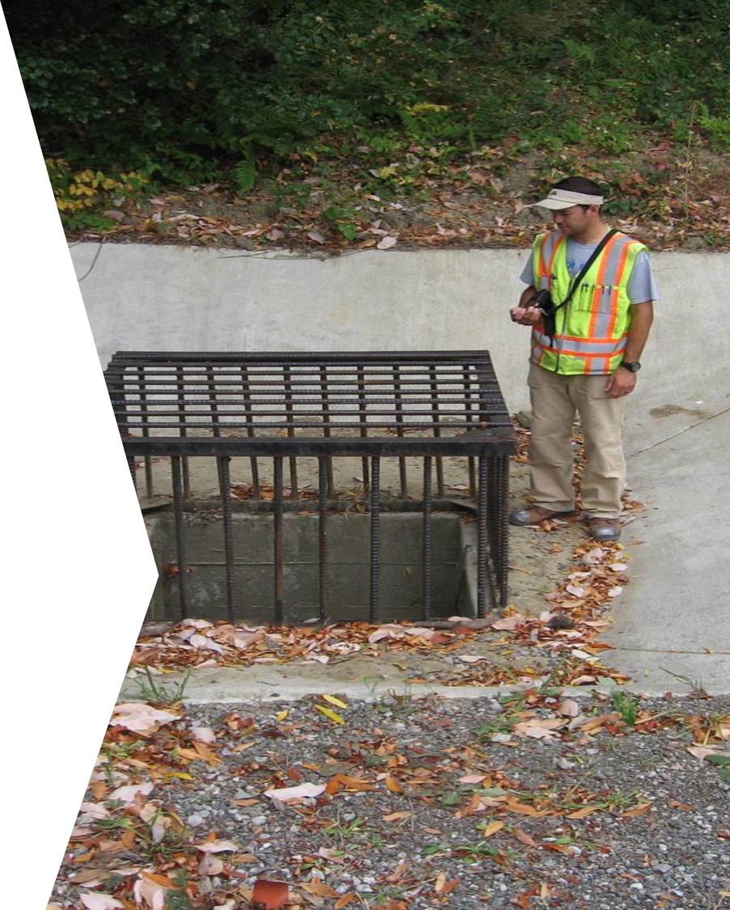
Essential Components

Slide 23
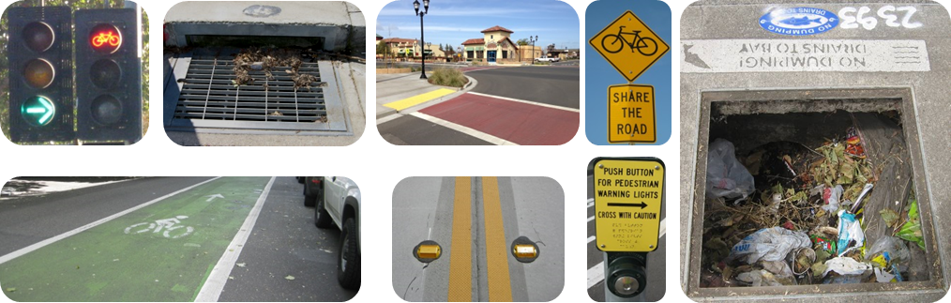
Essential Components Include:
They add up … approximately 30% of total needs!

Slide 24
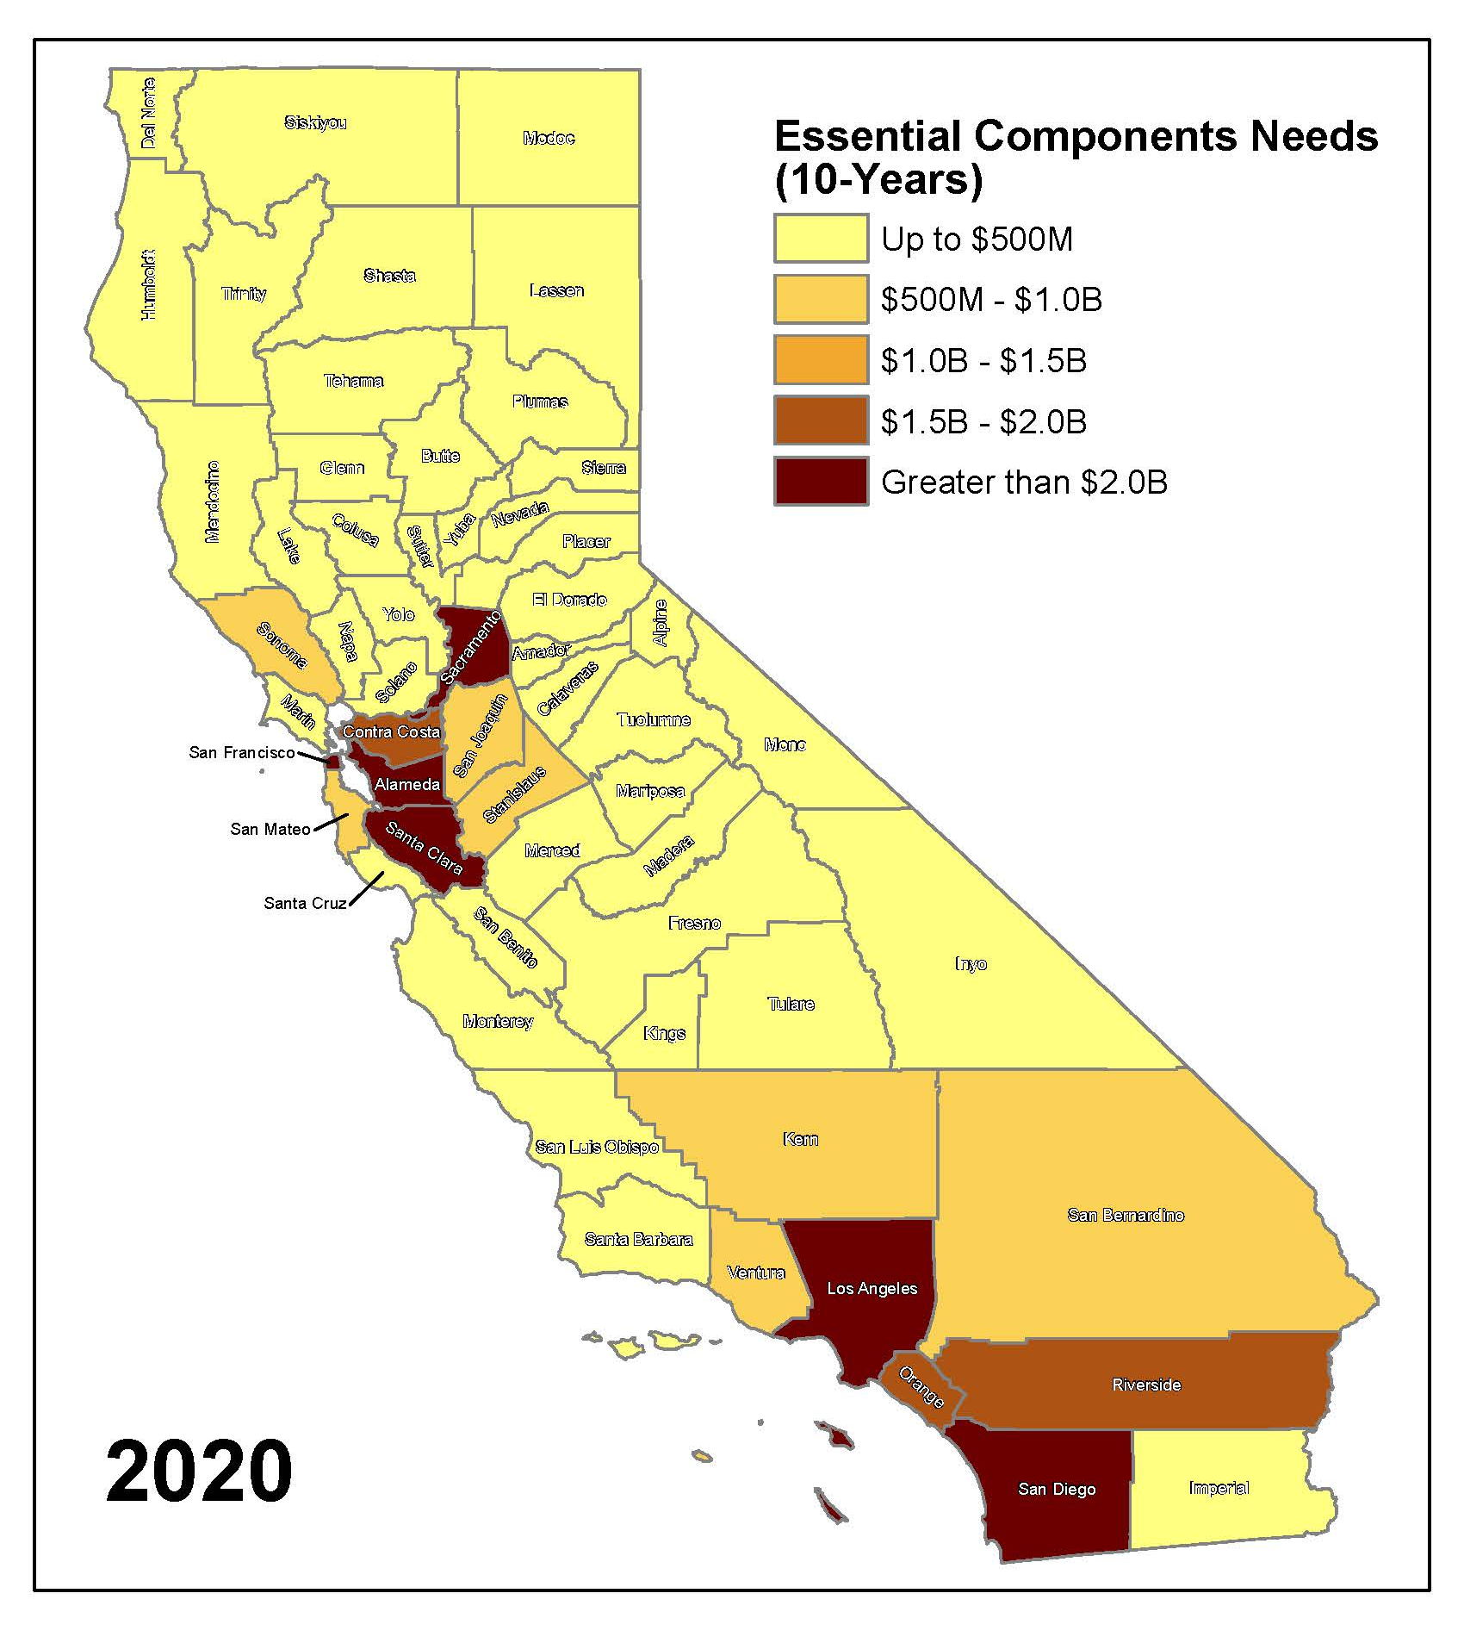
Essential Components Needs by County
$35.5 Billion
See final report (Appendix D) for your county’s data
LA county needs $6.4 billion

Slide 25
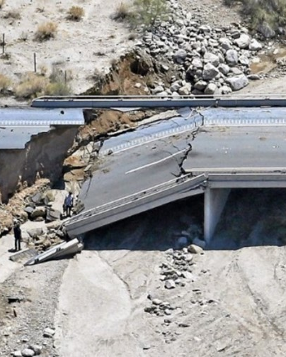
Local Bridges
From:
Quincy Engineering
Spy Pond Partners

Slide 26
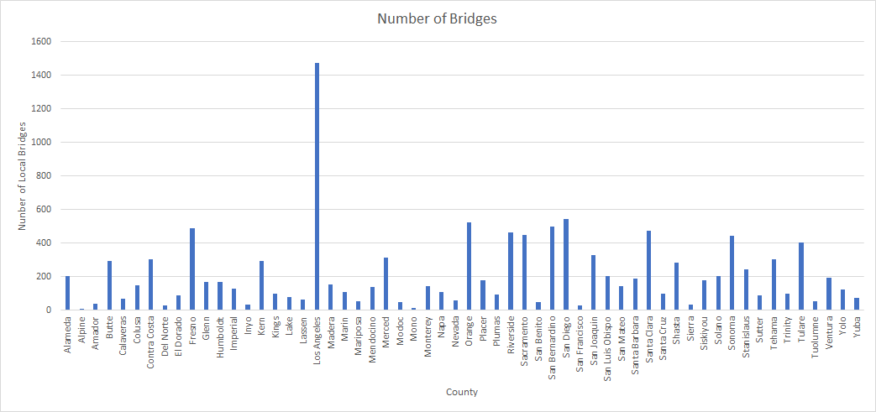
Cities & Counties Own 12,339 Bridges

Slide 27
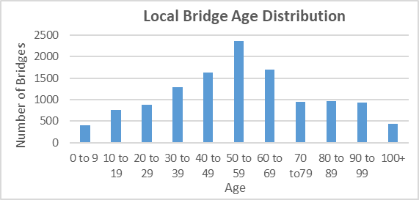
How Old Are Local Bridges?
Almost 20% are more than 80 years old

Slide 28
Bridge Conditions (Local & State)

Slide 29
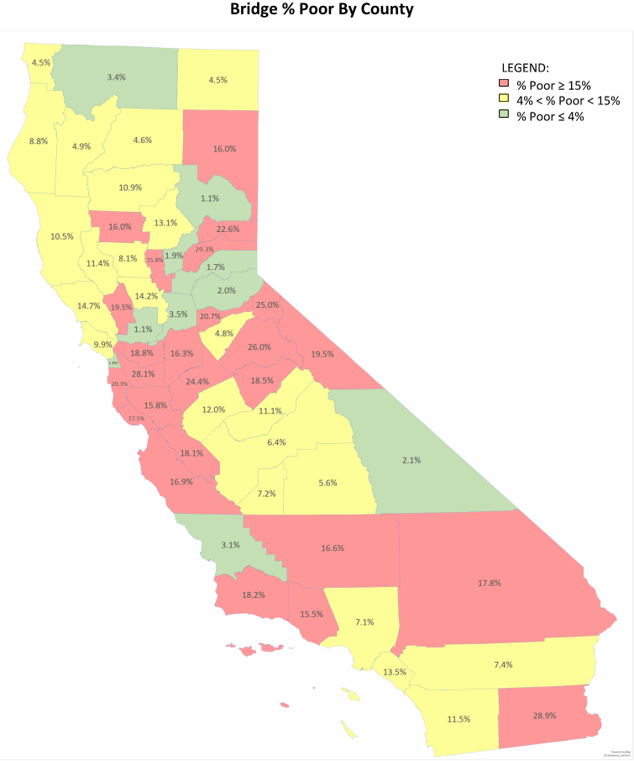
Bridges
Percent Poor by County
Over 4,800 bridges need repair or replacement
Notes:
Red % poor>= 15%
Yellow between 4-15%
Green <4%

Slide 30
Local Bridge Needs
$7.2 billion

Slide 31
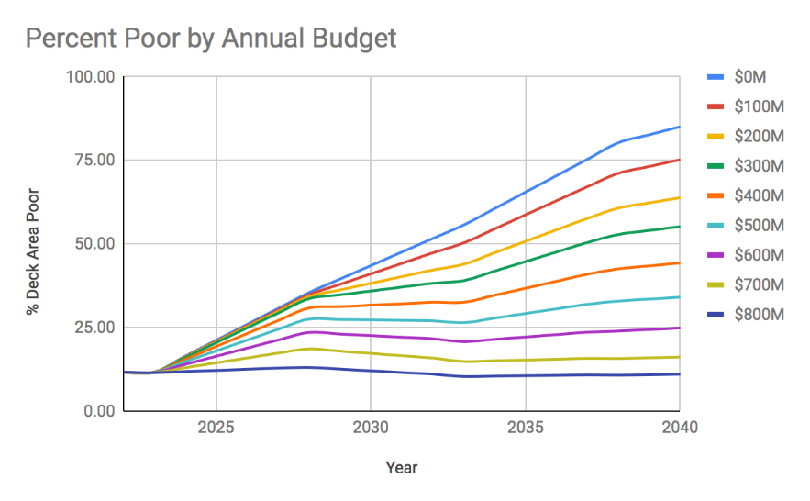
Actual funding $290 m/year
Funding of $800 m/year is needed to keep % poor the same

Slide 32
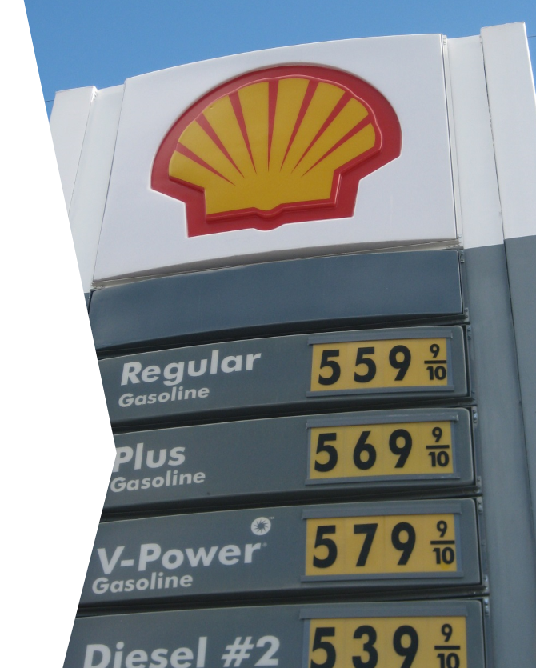
How is SB 1 Helping?

Slide 33
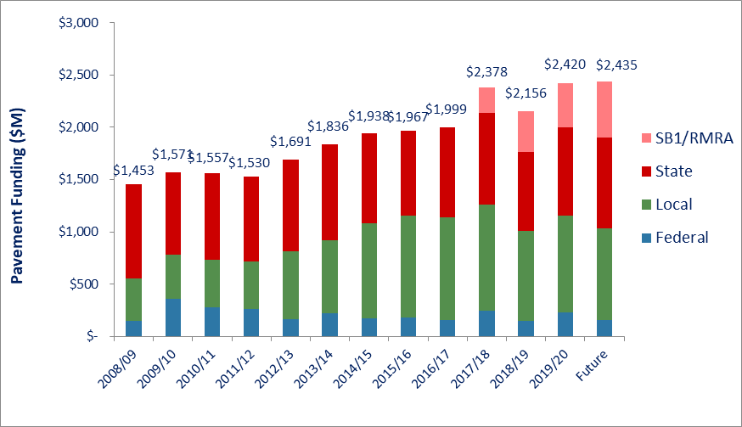
Funding Trends
SB1 is adding $533 m (22%)

Slide 34
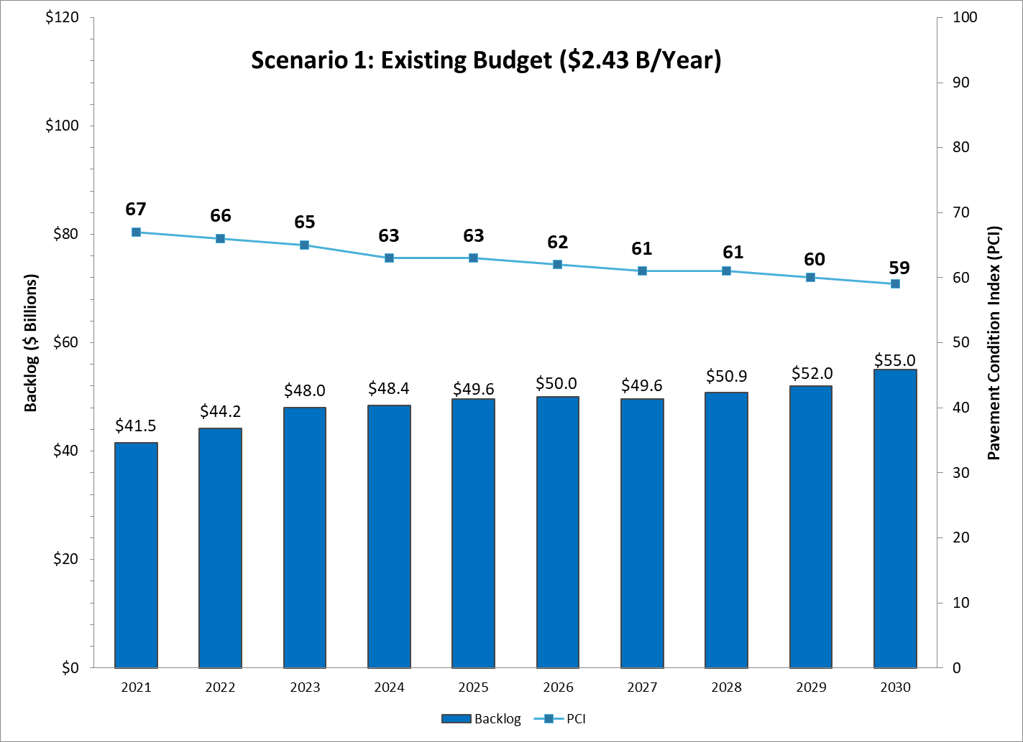
SB1 slowed the decline (by about 4 points)

Slide 35
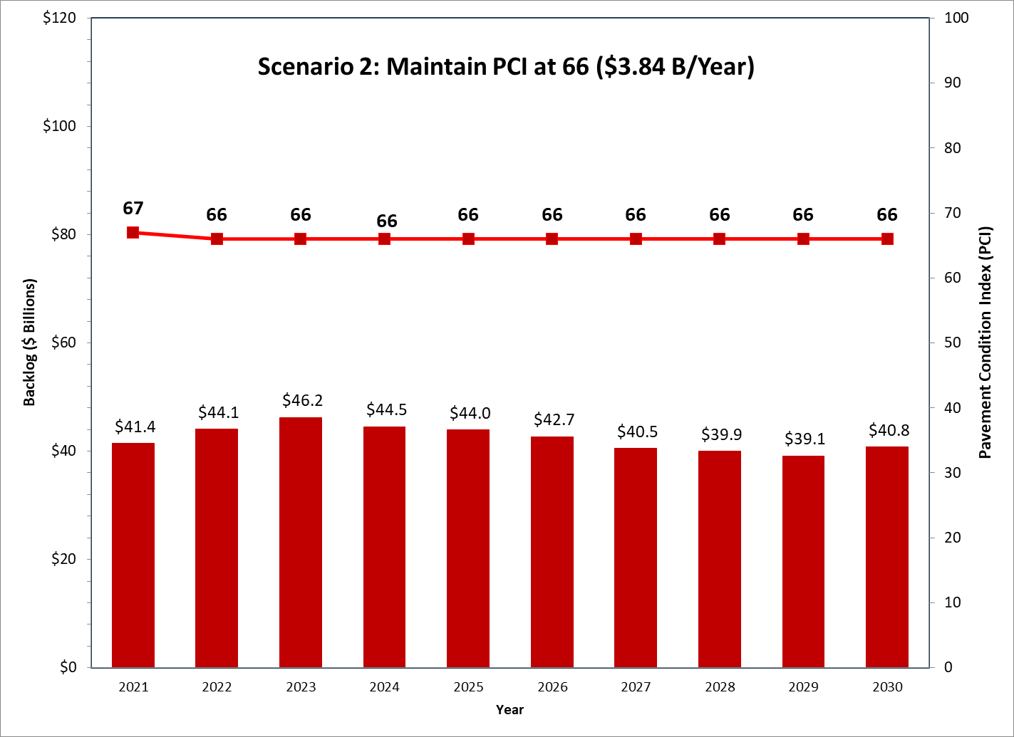
Higher paving costs = more funding needed
Notes:
2018
$3.08 billion/year to stay at PCI =65 (DM = $36 b)

Slide 36
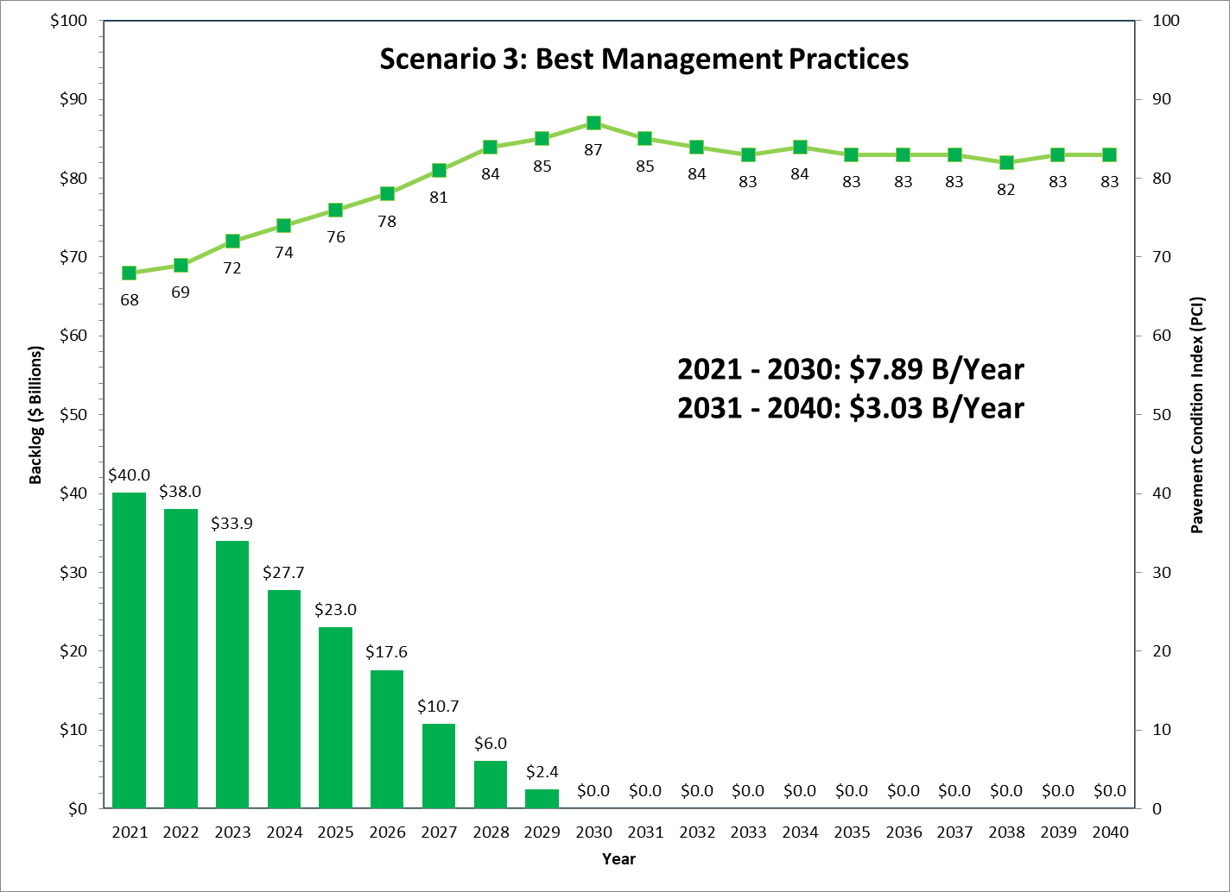
Higher paving costs = more funding needed
Notes:
2018
$6.8 billion/year then $2.5 billion

Slide 37
Statewide Needs Summary

Slide 38
Funding Shortfall for [City/County]
City/County has a funding shortfall of ____ if SB1 funding is lost.
City/County has a backlog of ____.
This is up/down since 2018. Why?
Other City/County specific details on the financial needs of the system.

Slide 39
Key Findings
SB 1 arrested historical deterioration over last 2 years
  Could be underestimated because PCI lags
  2018 was a conservative year due to repeal efforts
  Not enough data to fully appreciate impacts of SB 1
Local bridges are still aging
  Over 4,800 bridges need repair or replacement
  Dedicated funding has been flat for over 10 years
Construction costs went up sharply
  Unintended consequence of SB1?
Funding shortfall of $64 billion exists

Slide 40
Questions?
Insert Name & Agency

